Slide 1
HTML:CREATING TABLE
Name: Karma Deejay Tshomo
Student No. : 05220171
Module: SYS207

Slide 2
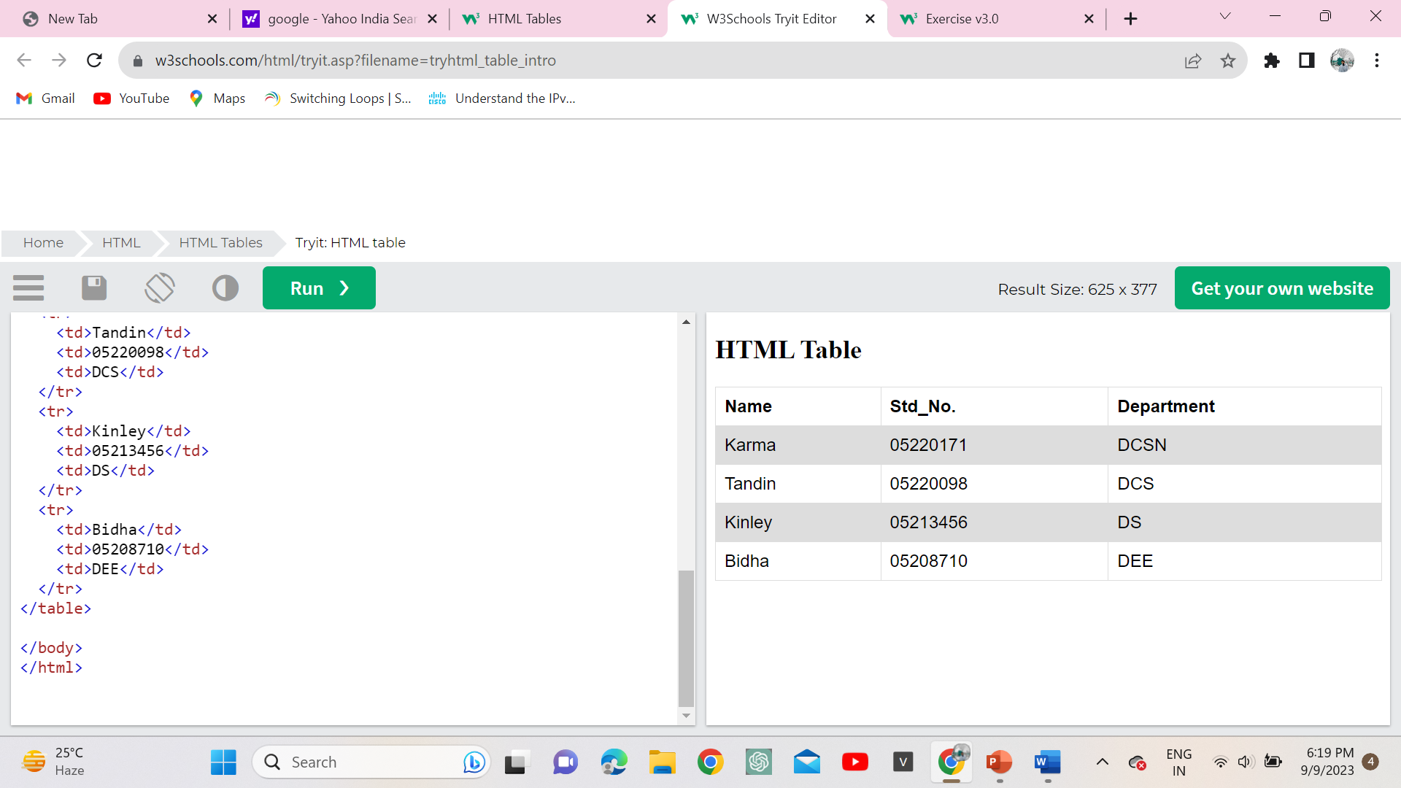
Introduction
HTML tables allow web developers to arrange data into rows and columns.
A table in HTML consists of table cells inside rows and columns.

Slide 3
Table Cells
Each table cell is defined by a <td> and a </td> tag.
td stands for table data.
Everything between <td> and </td> are the content of the table cell.
<table> <tr> <td>karma</td> <td>Tandin</td> <td>Kinley</td> </tr> </table>

Slide 4
Table Rows
<table>
<tr>
<th>Name</th>
<th>Std_No.</th>
<th>Department</th>
</tr> <tr>
<td>Karma</td>
<td>05220171</td>
<td>DCSN</td>
</tr>
<tr>
<td>Tandin</td>
<td>05220098</td>
<td>DCS</td>
</tr> </table>
Each table row starts with a <tr> and ends with a </tr> tag.
tr stands for table row.

Slide 5
Table Headers
Table headers cells can be used if we want our table to be in header cell therefore in those cases use the <th> tag instead of the <td> tag.
th stands for table header.
By default, the text in <th> elements are bold and centered.

Slide 6
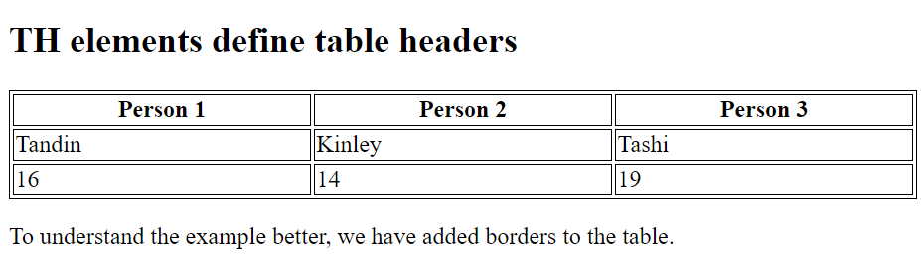
Example
Let the first row be table header cells
<table> <tr> <th>Person 1</th> <th>Person 2</th> <th>Person 3</th> </tr> <tr> <td>Emil</td> <td>Tobias</td> <td>Linus</td> </tr> <tr> <td>16</td> <td>14</td> <td>10</td> </tr> </table>

Slide 7
Tag | Description
<table> | Defines a table
<th> | Defines a header cell in a table
<tr> | Defines a row in a table
<td> | Defines a cell in a table

Slide 8
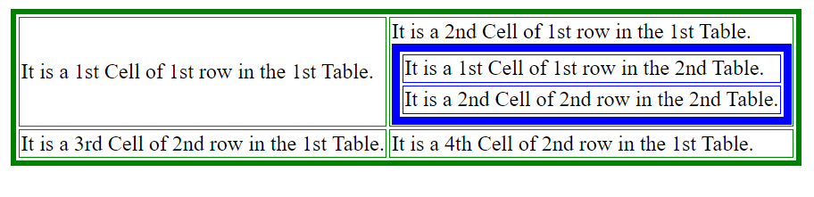
HTML Nested Table
The nested table in HTML means creating a table on a webpage inside another table on the same web page.
The inner table always has to be placed between the <td> .......... </td> of the outer table.

Slide 9
THANK YOU

